Slide 1
CAPSTONE PROJECT
WEATHER DATA ANALYSIS
Presented By:
A. K. ANEES FATHIMA (2021301002)
Alagappa College of Technology, Anna University
B.Tech Ceramic Technology

Slide 2
OUTLINE
Problem Statement
Proposed System/Solution
System Development Approach
Algorithm & Deployment
Result
Conclusion
Future Scope
References

Slide 3
PROBLEM STATEMENT
Development of a model to collect, analyze and visualize weather data from an app, enabling the users to track their weather in their surroundings and also whether the location has affected by storm or in future it will be affected.

Slide 4
PROPOSED SOLUTION
Development of a Python based data science project to collect, analyze and visualize the weather conditions such as temperature, pressure, humidity etc and also to analyze whether the place was affected by storm and it’s conditions.

Slide 5
SYSTEM APPROACH
SYSTEM REQUIREMENTS
1.HARDWARE:
A computer with adequate processing power.
Adequate RAM to handle the size of the dataset and computational requirements
2.SOFTWARE:
LIBRARY REQUIREMENTS
-Pandas
-NumPy
-Matplotlib
-Plotly

Slide 6
ALGORITHM & DEPLOYMENT
Data Collection:
Collect data related to weather such as temperature, pressure, humidity, wind direction, location.
Data Cleaning:
Clean the collected data by handling missing values, outliers, and inconsistencies.
Data Exploration:
Visualize the data using appropriate plots such as histograms, scatter plots, and time series plots.

Slide 7
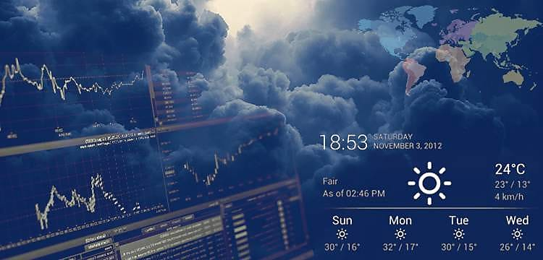
RESULT
Input data:
Surface weather observation data via OpenWeather API in JSON format. 4 rows X 24 columns.
Output data:
wxanal.csv:
5 rows X 17 columns: Cumulus_clouds (True/False), Divergence (True/False), Humidity (%), Location 1, Location 2, Location 3, Location 4, Pressure (hPa), Scattered_storms (True/False), Severe_storms (True/False), Temperature (Imperial: Fahrenheit), Theta-e (Kelvin), Wind direction (degrees), Wind speed (Imperial: miles/hour), Wind_shift (True/False), delta_thetae (degrees)

Slide 8
CONCLUSION
This Python project successfully analyzed historical weather data to identify patterns and trends in storms. Through data visualization and statistical analysis, we gained insights into storm frequency, severity, and distribution across different regions. The project demonstrated the effectiveness of using Python libraries like Pandas, Matplotlib, and NumPy for data processing and visualization. Moving forward, further refinement of the analysis techniques and the integration of real-time data could enhance the project's utility for weather forecasting and disaster preparedness

Slide 9
FUTURE SCOPE
The project lays a solid foundation for future developments in weather and storm analysis using Python. Some potential areas for future scope include:
Real-time Data Integration: Implementing APIs or data streaming to incorporate real-time weather data for up-to-date analysis and forecasting.
Machine Learning Models: Exploring machine learning algorithms such as clustering or time series forecasting to improve storm prediction accuracy.
User Interface Development: Building a user-friendly interface (e.g., with Dash or Flask) to allow users to interact with the data and obtain customized reports.
Integration with Emergency Response Systems: Collaborating with emergency response agencies to integrate analysis results into disaster response planning and decision-making.

Slide 10
REFERENCES
Johns, R. H., and C. A. Doswell, 1992: Severe local storms forecasting. Wea. Forecasting, 7, 588–612, DOI:10.1175/1520-0434(1992)007,0588:SLSF.2.0.CO;2.
Revering, Andrew. “Equivalent Potential Temperature.” gradsusr.org/pipermail/gradsusr/2010-January/010266.html. Accessed 8 October 2020.

Slide 11
THANK YOU

